Slide 1

Design Pattern
Recurring Solutions to Recurring Problems

Slide 2
What is a Design Pattern?
A Design Pattern
  describes a problem
    Occurring over and over again (in software engineering)
  describes the solution
    Sufficiently generic
    Applicable in a wide variety of contexts.
Recurring Solution to a Recurring Problem

Slide 3
Essential Elements of a Design Pattern
Pattern Name: Descriptor for a design problem, its solutions, and their consequences.
Problem: Where to apply the pattern and its associated context.
Solution: Elements that make up the design, their relationships, responsibilities, and collaborations.
Consequences: Results and trade-offs in applying the pattern.

Slide 4
Describing a Design Pattern
Every Design Pattern is Described in a specific format
We first illustrate an example before presenting the generic format for description
  Example of Iterator Pattern
Software Engineering

Slide 5
Iterator Pattern
CONTAINERS
Array
Vector
List
Stack
Queue
Tree
Pattern Name and Classification:
  Iterator
  Behavioral
Intent
  Provide a way to access
  the elements
  of an aggregate object (container)
  sequentially
  without exposing its underlying representation.
ACCESS
Read
Write
Read-Write
SEQUENTIAL
Forward
Backward
Bidirectional
Random
Software Engineering

Slide 6
Iterator Pattern
Also Known As
  Cursor
Motivation
  An aggregate object (list) should have a way to access its elements without exposing its internal structure.
  There is a need to traverse the list in different ways, depending on a specific task.
  Multiple traversals may be pending on the same list.
  The key idea in this pattern is to take the responsibility for access and traversal out of the list object and put it into an iterator object.
Software Engineering

Slide 7
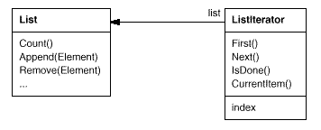
Iterator Pattern
Motivation
Software Engineering

Slide 8
Iterator Pattern
Applicability
  to access an aggregate object's contents without exposing its internal representation.
  to support multiple traversals of aggregate objects.
  to provide a uniform interface for traversing different aggregate structures (that is, to support polymorphic iteration).
Software Engineering

Slide 9
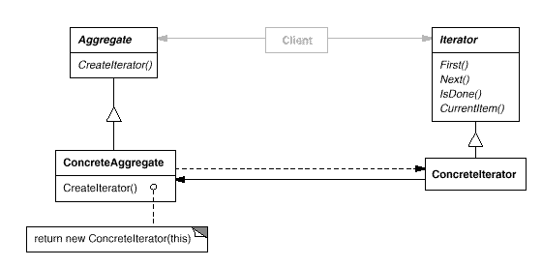
Iterator Pattern
Structure
Software Engineering

Slide 10
Iterator Pattern
Participants
  Iterator
    defines an interface for accessing and traversing elements.
  ConcreteIterator
    implements the Iterator interface.
    keeps track of the current position in the traversal of the aggregate.
  Aggregate
    defines an interface for creating an Iterator object.
  ConcreteAggregate
    implements the Iterator creation interface to return an instance of the proper ConcreteIterator.
Software Engineering

Slide 11
Iterator Pattern
Collaborations
  A ConcreteIterator keeps track of the current object in the aggregate and can compute the succeeding object in the traversal.
Conséquences
  It supports variations in the traversal of an aggregate.
  Iterators simplify the Aggregate interface.
  More than one traversal can be pending on an aggregate.
Software Engineering

Slide 12
Iterator Pattern
Sample Implementation – Follows in the next few slides.
Software Engineering

Slide 13
Iterator Pattern
interface IIterator
{
public boolean hasNext();
public Object next();
}
interface IContainer
{
public IIterator createIterator();
}
Software Engineering

Slide 14
Iterator Pattern
class BooksCollection implements IContainer
{
private String m_titles[] = {"Design Patterns","1","2","3","4"};
public IIterator createIterator()
{
BookIterator result = new BookIterator();
return result;
}
Software Engineering

Slide 15
Iterator Pattern
  private class BookIterator implements IIterator
  {
  private int m_position;
  public boolean hasNext()
  {
  if (m_position < m_titles.length)
  return true;
  else
  return false;
  }
Software Engineering

Slide 16
Iterator Pattern
    public Object next()
    {
    if (this.hasNext())
    return m_titles[m_position++];
    else
    return null;
    }
}
}
Software Engineering

Slide 17
Design Pattern
Recurring Solutions to Recurring Problems

Slide 18
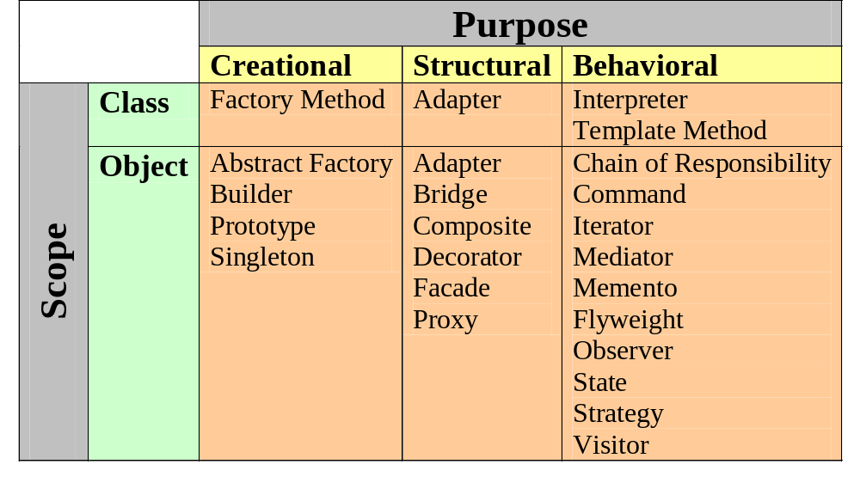
Catalogue of Design Patterns (GoF)

Slide 19
Pros of Design Patterns
Help capture and disseminate expert knowledge.
  Promotes reuse and avoid mistakes.
Provide a common vocabulary:
  Help improve communication among the developers.
Reduce the number of design iterations:
  Help improve the design quality and designer productivity.
Software Engineering

Slide 20
Pros of Design Patterns
Patterns solve software structural problems attributable to:
  Abstraction,
  Encapsulation
  Information hiding
  Separation of concerns
  Coupling and cohesion
  Separation of interface and implementation
  Single point of reference
  Divide and conquer
Software Engineering

Slide 21
Cons of Design Patterns
Design patterns do not directly lead to code reuse.
To help select the right design pattern at the right point during a design exercise.
  At present no methodology exists
Software Engineering

Slide 22
Singleton Design Patterns
The UNIQUE Object
Software Engineering

Slide 23
Singleton Pattern
Problem:
  Managing entities with one-instance-at-a-time
  Office of the Director of IIT
  Heart in a Human Body
  cout, cin, cerr, clog …
Solution:
  Protect creation and Have unique access only
Consequences:
  Synchronization needed for multi-threaded use
Note:
  Closely related to Monostate Pattern
Software Engineering

Slide 24
Singleton Pattern
Pattern Name and Classification:
  Singleton
  Creational
Intent
  Ensure a class only has one instance, and provide a global point of access to it.
Also Known As
Software Engineering

Slide 25
Singleton Pattern
Motivation
  It's important for some classes to have exactly one instance.
  How do we ensure that a class has only one easily accessible instance? A global variable makes an object accessible, but it doesn't keep you from instantiating multiple objects.
  Make the class responsible for keeping track of its sole instance.
Software Engineering

Slide 26
Singleton Pattern
Applicability
  Use the Singleton pattern when l there must be exactly one instance of a class, and it must be accessible to clients from a well-known access point.
  when the sole instance should be extensible by subclassing, and clients should be able to use an extended instance without modifying their code.
Software Engineering

Slide 27
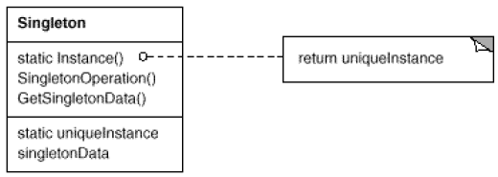
Singleton Pattern
Structure
Software Engineering

Slide 28
Singleton Pattern
Participants
  Singleton
    defines an Instance operation that lets clients access its unique instance. Instance is a class operation (that is, a static member function in C++).
    may be responsible for creating its own unique instance.
Collaborations
  Clients access a Singleton instance solely through Singleton's Instance operation.
Software Engineering

Slide 29
Singleton Pattern
Consequences
  Controlled access to sole instance.
  Reduced name space.
  Permits refinement of operations and representation.
  Permits a variable number of instances.
  More flexible than class operations.
Software Engineering

Slide 30
Singleton Pattern
class Singleton {
private static Singleton instance;
private Singleton() { ... }
public static synchronized Singleton getInstance() {
if (instance == null)
instance = new Singleton();
return instance;
}
...
public void doSomething() { …. }
}
Software Engineering

Slide 31
Lazy instantiation
class Singleton {
private static Singleton instance;
private Singleton() { …. }
public static Singleton getInstance() {
if (instance == null) {
synchronized(Singleton.class) {
if (instance == null) {
instance = new Singleton();
}
}
}
return instance;
}
public void doSomething() { … }
}

Slide 32
Command Design Pattern
The World of Delegation
Software Engineering

Slide 33
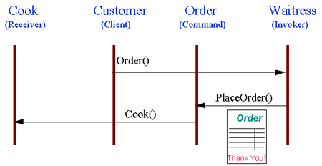
“Check @ Diner” – A Command Pattern
Customer places an Order with Waitress
Waitress writes Order on check.
Order is queued to Cook.
Software Engineering
Notes:
Note that the pad of "checks" used by different diners is not dependent on the menu, and therefore they can support commands to cook many different items.

Slide 34
“Compose & Send Mail” –
A Command Pattern
Sender composes a Mail with Word and presses “Send”
Mail is queued on Outbox.
SendMail thread checks the connection and send the Mails from Outbox.
Software Engineering

Slide 35
Command Pattern
Pattern Name and Classification:
  Command
  Behavioral
Intent
  Encapsulate requests for service from an object inside other objects to allow manipulation of the requests in various ways
Also Known As
  Action, Transaction

Slide 36
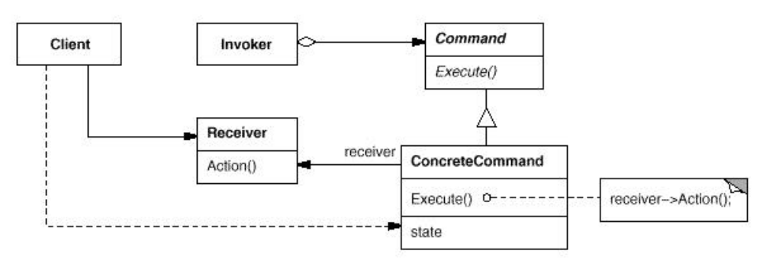
Command Pattern
Structure
Interface Separation
Time Separation
Software Engineering

Slide 37
Multiple File System
public interface FileSystemReceiver {
void openFile();
void writeFile();
void closeFile();
}
public class UnixFileSystemReceiver implements FileSystemReceiver {
public void openFile() {
System.out.println("Opening file in unix OS");
}
public void writeFile() {
System.out.println("Writing file in unix OS");
}
……
}

Slide 38
Command Classes
public interface Command {
void execute();
}
public class OpenFileCommand implements Command {
private FileSystemReceiver fileSystem;
public OpenFileCommand(FileSystemReceiver fs){
this.fileSystem=fs;
}
public void execute() {
//open command is forwarding request to openFile method
this.fileSystem.openFile();
}
}

Slide 39
The Command Invoker
public class FileInvoker {
public Command command;
public FileInvoker(Command c){
this.command=c;
}
public void execute(){
this.command.execute();
}
}

Slide 40
File system Client application
public class FileSystemClient {
public static void main(String[] args) {
FileSystemReceiver fs = FileSystemReceiverUtil.getUnderlyingFileSystem();
OpenFileCommand openFileCommand = new OpenFileCommand(fs);
FileInvoker file = new FileInvoker(openFileCommand);
file.execute();
WriteFileCommand writeFileCommand = new WriteFileCommand(fs);
file = new FileInvoker(writeFileCommand);
file.execute();
CloseFileCommand closeFileCommand = new CloseFileCommand(fs);
file = new FileInvoker(closeFileCommand);
file.execute();
}
}

Slide 41
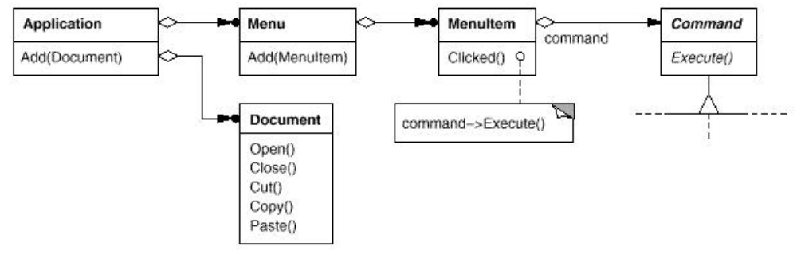
Command Pattern
Motivation
Software Engineering

Slide 42
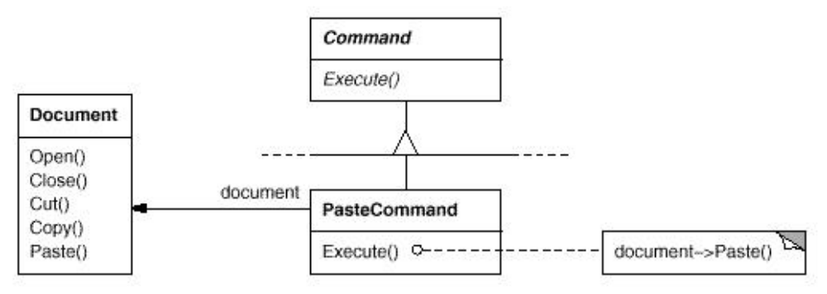
Command Pattern
Motivation
Software Engineering

Slide 43
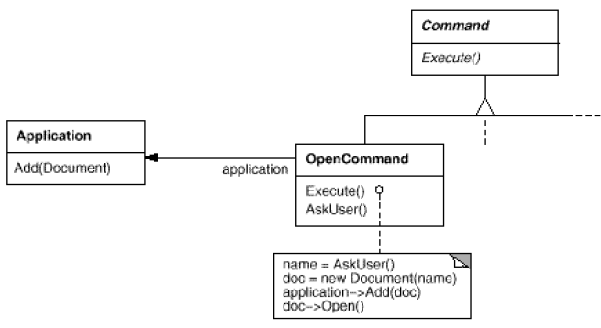
Command Pattern
Motivation
Software Engineering

Slide 44
Command Pattern
Applicability
  The Command pattern can be used
    To implement a callback function capability
    To specify, queue, & execute requests at different times
    To support undo and change log operations
Software Engineering

Slide 45
Command Pattern
Structure
Interface Separation
Time Separation
Software Engineering

Slide 46
Command Pattern
Participants
  Command
    declares an interface for executing an operation.
  ConcreteCommand (PasteCommand, OpenCommand)
    defines a binding between a Receiver object and an action.
    implements Execute by invoking the corresponding operation(s) on Receiver.
  Client (Application)
    creates a ConcreteCommand object and sets its receiver.
  Invoker (MenuItem)
    asks the command to carry out the request.
  Receiver (Document, Application)
    knows how to perform the operations associated with carrying out a request. Any class may serve as a Receiver.
Software Engineering

Slide 47
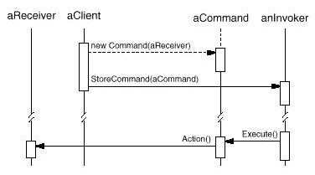
Command Pattern
Collaborations
Software Engineering

Slide 48
Command Pattern
Consequences
  Command decouples the object that invokes the operation from the one that knows how to perform it
  Commands can be manipulated and extended like any other object.
  Commands can be made into a composite command
Software Engineering

Slide 49
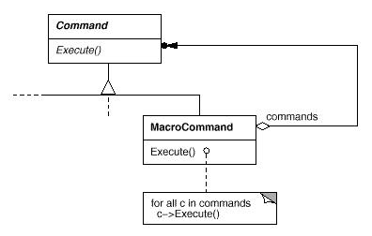
Command Pattern
Macro / Composite Command
Software Engineering

Slide 50
Command Pattern
Implementation Issues
  How intelligent should a command object be?
  Dumb: Delegates the required action to a receiver object
  Smart: Implements everything itself without delegating to a receiver object at all
Use Functor?
  Active Command:
    A functor object usually implements the desired behavior itself without delegation to another object.
  Forwarding Command:
    A command object frequently delegates the desired behavior to another receiver object.
Software Engineering

Slide 51
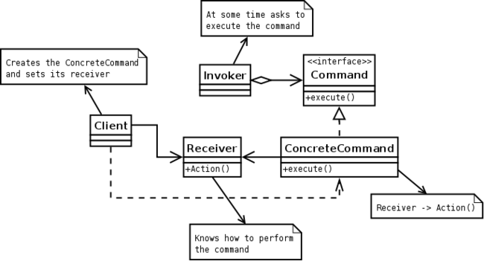
Command Pattern: Request-in-Object
Software Engineering

Slide 52
Sample Command Pattern Usage
Multi-level undo / redo
  The program can keep a pair of stacks of commands.
Transactional behavior
  Rollback for all-or-none operations
  Installers / Databases.
  Two-phase commit.
Progress bars
Software Engineering

Slide 53
Sample Command Pattern Usage
GUI buttons and menu items
  In Swing and Borland Delphi programming, an Action is a command object.
Thread pools / Parallel Processing
  Master/Worker pattern
Macro recording
Command across Network
  Player actions in computer games.
Mobile Code
  Deliver a new behavior to remote locations
Software Engineering

Slide 54
Visitor Design Patterns
Adding Methods to a Object Structure
Double Dispatch
Software Engineering

Slide 55
Visitor Pattern
Pattern Name and Classification:
  Visitor
  Behavioral
Intent
  Represent an operation to be performed on the elements of an object structure. Visitor lets you define a new operation without changing the classes of the elements on which it operates.
Also Known As
Software Engineering

Slide 56
Visitor Pattern
Motivation
  An object structure (multiple hierarchies possible) is given – this rarely change
  Number of operations to be performed on the classes of the hierarchy
  All operations may not be defined for all classes
  Need to add operations without changing (recompiling the hierarchy)
Software Engineering

Slide 57
Visitor Pattern
Applicability
  Use the Visitor pattern when an object structure contains many classes of objects with differing interfaces, and you want to perform operations on these objects that depend on their concrete classes.
Software Engineering

Slide 58
Visitor Pattern
Applicability
  many distinct and unrelated operations need to be performed on objects in an object structure, and you want to avoid "polluting" their classes with these operations. Visitor lets you keep related operations together by defining them in one class. When the object structure is shared by many applications, use Visitor to put operations in just those applications that need them.
Software Engineering

Slide 59
Visitor Pattern
Applicability
  the classes defining the object structure rarely change, but you often want to define new operations over the structure. Changing the object structure classes requires redefining the interface to all visitors, which is potentially costly. If the object structure classes change often, then it's probably better to define the operations in those classes.
Software Engineering

Slide 60
Item Element Class Hierarchy
public class Book implements ItemElement {
private int price; private String isbnNumber;
public Book(int cost, String isbn){
this.price=cost; this.isbnNumber=isbn;
}
public int getPrice() { return price; }
public String getIsbnNumber() { return isbnNumber; }
@Override
public int accept(ShoppingCartVisitor visitor) {
return visitor.visit(this);
}
}

Slide 61
Item Element Class Hierarchy
public class Fruit implements ItemElement {
rivate int pricePerKg; private int weight; private String name;
public Fruit(int priceKg, int wt, String nm){
this.pricePerKg=priceKg; this.weight=wt; this.name = nm; }
public int getPricePerKg() { return pricePerKg; }
public int getWeight() { return weight; }
public String getName(){ return this.name; }
@Override
public int accept(ShoppingCartVisitor visitor) {
return visitor.visit(this);
}
}

Slide 62
Shopping Cart Client
public class ShoppingCartClient {
public static void main(String[] args) {
ItemElement[] items = new ItemElement[]{new Book(20, "1234"),new
Book(100, "5678"), new Fruit(10, 2, "Banana"), new Fruit(5, 5, "Apple")};
int total = calculatePrice(items);
System.out.println("Total Cost = "+total);
}
private static int calculatePrice(ItemElement[] items) {
ShoppingCartVisitor visitor = new ShoppingCartVisitorImpl();
int sum=0;
for(ItemElement item : items) { sum = sum + item.accept(visitor); }
return sum;
}
}

Slide 63
Add a visitor
public class ShoppingCartVisitorImpl implements ShoppingCartVisitor {
public int visit(Book book) {
int cost=0;
if(book.getPrice() > 50){ cost = book.getPrice()-5; }
else cost = book.getPrice();
System.out.println("Book ISBN::"+book.getIsbnNumber() + " cost ="+cost);
return cost;
}
public int visit(Fruit fruit) {
int cost = fruit.getPricePerKg()*fruit.getWeight();
System.out.println(fruit.getName() + " cost = "+cost);
return cost;
}
}

Slide 64
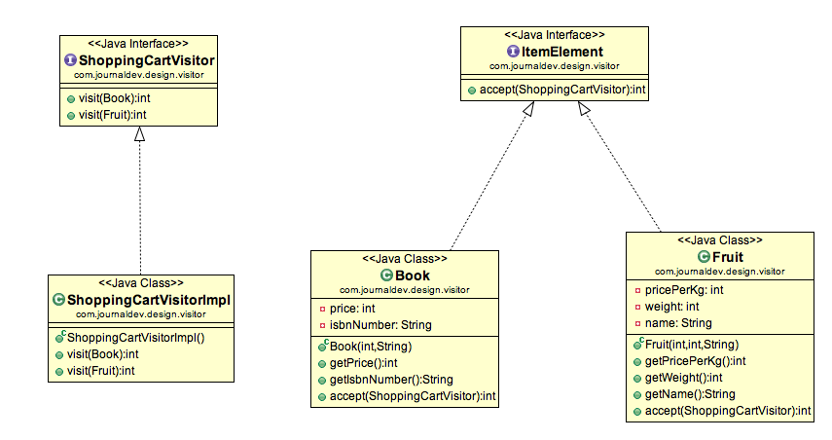
Shopping Cart Visitor Pattern

Slide 65
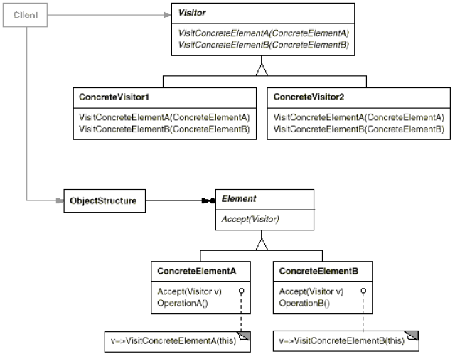
Visitor Pattern: Structure
Structure
Mar-12
Software Engineering

Slide 66
Visitor Pattern: Participant
Visitor (NodeVisitor)
  declares a Visit operation for each class of ConcreteElement in the object structure. The operation's name and signature identifies the class that sends the Visit request to the visitor. That lets the visitor determine the concrete class of the element being visited. Then the visitor can access the element directly through its particular interface.
Software Engineering

Slide 67
Visitor Pattern: Participant
ConcreteVisitor
  implements each operation declared by Visitor. Each operation implements a fragment of the algorithm defined for the corresponding class of object in the structure. ConcreteVisitor provides the context for the algorithm and stores its local state. This state often accumulates results during the traversal of the structure.
Software Engineering

Slide 68
Visitor Pattern: Participant
Element (Node)
  defines an Accept operation that takes a visitor as an argument.
ConcreteElement
  implements an Accept operation that takes a visitor as an argument.
Software Engineering

Slide 69
Visitor Pattern: Participant
ObjectStructure
  can enumerate its elements.
  may provide a high-level interface to allow the visitor to visit its elements.
  may either be a composite or a collection such as a list or a set.
Software Engineering

Slide 70
Visitor Pattern: Collaboration
A client that uses the Visitor pattern must create a ConcreteVisitor object and then traverse the object structure, visiting each element with the visitor.
When an element is visited, it calls the Visitor operation that corresponds to its class. The element supplies itself as an argument to this operation to let the visitor access its state, if necessary.
Software Engineering

Slide 71
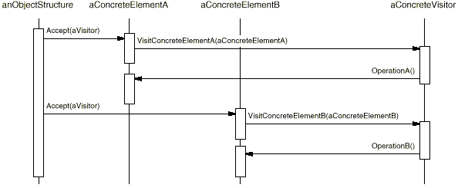
Visitor Pattern: Collaboration
The following interaction diagram illustrates the collaborations between an object structure, a visitor, and two elements:
Software Engineering

Slide 72
Visitor Pattern: Consequences
Visitor makes adding new operations easy.
  Visitors make it easy to add operations that depend on the components of complex objects. You can define a new operation over an object structure simply by adding a new visitor. In contrast, if you spread functionality over many classes, then you must change each class to define a new operation.
Software Engineering

Slide 73
Visitor Pattern: Consequences
A visitor gathers related operations and separates unrelated ones.
  Related behavior isn't spread over the classes defining the object structure; it's localized in a visitor. Unrelated sets of behavior are partitioned in their own visitor subclasses. That simplifies both the classes defining the elements and the algorithms defined in the visitors. Any algorithm-specific data structures can be hidden in the visitor.
Software Engineering

Slide 74
Visitor Pattern: Consequences
Adding new ConcreteElement classes is hard.
  The Visitor pattern makes it hard to add new subclasses of Element. Each new ConcreteElement gives rise to a new abstract operation on Visitor and a corresponding implementation in every ConcreteVisitor class. If the Element class hierarchy is stable, but you are continually adding operations or changing algorithms, then the Visitor pattern will help you manage the changes.
Software Engineering

Slide 75
Visitor Pattern: Consequences
Visiting across class hierarchies.
  An iterator can visit the objects in a structure as it traverses them by calling their operations. But an iterator can't work across object structures with different types of elements. All elements the iterator can visit have a common parent class Item.
Software Engineering

Slide 76
Visitor Pattern: Consequences
  Visitor does not have this restriction. It can visit objects that don't have a common parent class. You can add any type of object to a Visitor interface.
Software Engineering

